Slide 1


Teaching Data Scientists How to develop the consistent Data Science curriculum to address key professional competences and skills
Yuri Demchenko, University of Amsterdam
EDISON Project and Initiative
Workshop 16 November 2018
Univ of Science and Technology, Windhoek, Namibia
https://github.com/EDISONcommunity/EDSF

Slide 2
Outline
Part 1
Background: Data driven research and demand for new skills
Foundation, recent reports, studies and facts
Part 2
EDISON Data Science Framework (EDSF)
Data Science competences and skills
Essential Data Scientist professional skills: Thinking and doing like Data Scientist
Data Science Professional Profiles
Data Science Body of Knowledge and Model Curriculum
Pat 3
Use of EDSF and Example curricula
Curriculum design
Competences assessment
Building Data Science team
Discussion

Slide 3
Yuri Demchenko, Senior Researcher, Lecturer, UvA
Graduated and PhD from National Technical University of Ukraine “Kiev Polytechnic Institute”
University of Amsterdam – since 2003
Research areas
Big Data Infrastructure and Data Science platforms
Cloud architecture, cloud automation and DevOps
Cloud security and compliance
Teaching courses (on campus and online)
Big Data Infrastructure and Technologies
Cloud powered Software Engineering and DevOps
Data Science Foundations, Professional Issues in Data Science
Security Engineering
Recent projects
EDISON: Building the Data Science Profession for Europe
MATES: Digitalisation of the European Blue Economy
CYCLONE: Multi-cloud automation platform for cloud based applications
GEANT4 Research: Cloud aware networking infrastructure provisioning on-demand

Slide 4
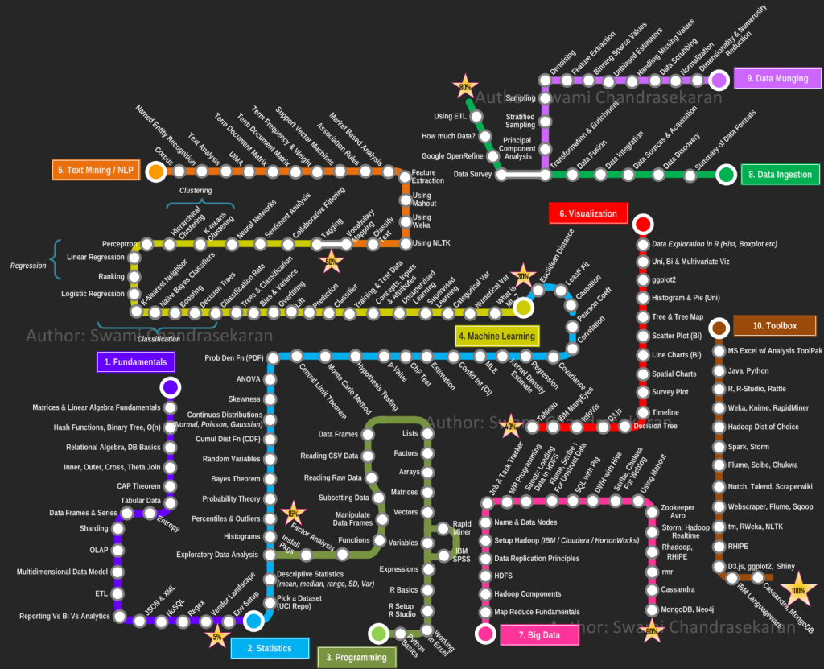
Becoming a Data Scientist by Swami Chandrasekaran (2013) http://nirvacana.com/thoughts/becoming-a-data-scientist/
Good and practical advice how to learn Data Science, step by step
Follow the route

Slide 5
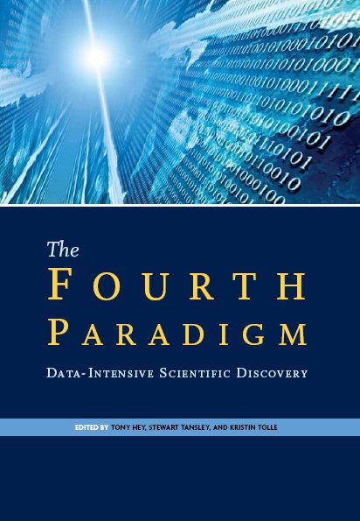


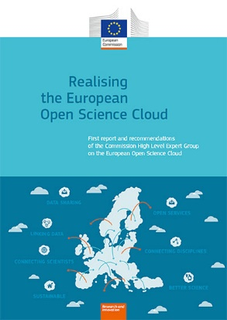
Visionaries and Drivers: Seminal works, High level reports, Activities
The Fourth Paradigm: Data-Intensive Scientific Discovery.
By Jim Gray, Microsoft, 2009. Edited by Tony Hey, Kristin Tolle, et al. http://research.microsoft.com/en-us/collaboration/fourthparadigm/
Riding the wave: How Europe can gain from the rising tide of scientific data.
Final report of the High Level Expert Group on Scientific Data. October 2010. http://cordis.europa.eu/fp7/ict/e-infrastructure/docs/hlg-sdi-report.pdf
The Data Harvest: How sharing research data can yield knowledge, jobs and growth.
An RDA Europe Report. December 2014
https://rd-alliance.org/data-harvest-report-sharing-data-knowledge-jobs-and-growth.html
https://www.rd-alliance.org/
HLEG report on European Open Science Cloud
(October 2016)
https://ec.europa.eu/research/openscience/pdf/realising_the_european_open_science_cloud_2016.pdf
Emergence of Cognitive Technologies
(IBM Watson, Cortana and others)

Slide 6
The Fourth Paradigm of Scientific Research
Theory, hypothesis and logical reasoning
Observation or Experiment, e.g.
Newton observed apples falling to design his theory of mechanics
Gallileo Galilei made experiments with falling objects from the Pisa leaning tower
Simulation of theory or model
Digital simulation can prove theory or model
Data-driven Scientific Discovery (aka Data Science)
More data beat hypothesized theory
e-Science as computing and Information Technologies empowered science
Computer-human - driven science?
Machine discovers new patterns and formulates hypothesis in one or multiples knowledge spaces
Scientist validates and designs additional texts or experiments

Slide 7
HLEG EOSC Report Essentials – Core Data Experts [ref]
Core Data Experts is a new class of colleagues with core scientific professional competencies and the communication skills to fill the gap between the two cultures.
Core data experts are neither computer savvy research scientists nor are they hard-core data or computer scientists or software engineers.
They should be technical data experts, though proficient enough in the content domain where they work routinely from the very beginning (experimental design, proposal writing) until the very end of the data discovery cycle
Converge two communities:
Scientists need to be educated to the point where they hire, support and respect Core Data Experts
Data Scientists (Core Data Experts) need to bring the value to scientific research and organisations
Implementation of the EOSC needs to include instruments to help train, retain and recognise this expertise,
In order to support the 1.7 million scientists and over 70 million people working in innovation.
[ref] https://ec.europa.eu/research/openscience/pdf/realising_the_european_open_science_cloud_2016.pdf

Slide 8
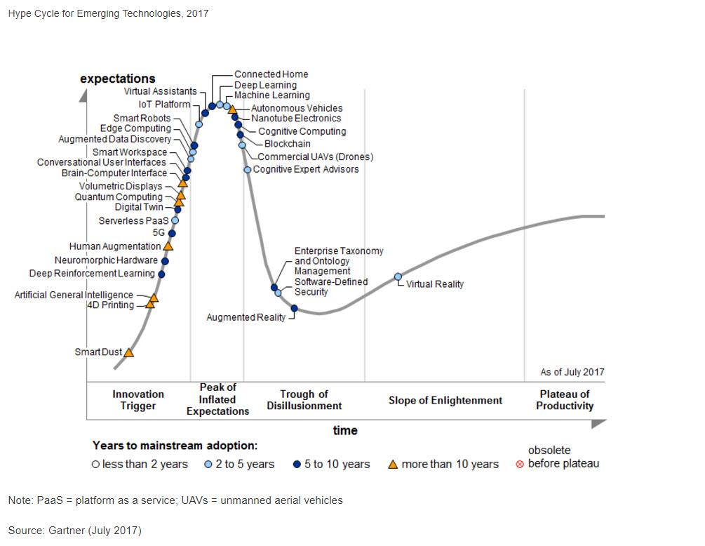
Gartner Technology Hypercycle (August 2017)
Big Data and Cloud Computing:
In a maturity stage –
already commodity services
[ref] https://www.gartner.com/smarterwithgartner/top-trends-in-the-gartner-hype-cycle-for-emerging-technologies-2017/

Slide 9
Gartner Technology Hypercycle (August 2017)
We are in post Big Data and post Cloud Computing stage
Big Data and Cloud Computing:
In a maturity stage –
already commodity services
[ref] https://www.gartner.com/smarterwithgartner/top-trends-in-the-gartner-hype-cycle-for-emerging-technologies-2017/

Slide 10
International and EU studies on data-driven skills

Slide 11
Industry reports on Data Science Analytics and Data enabled skills demand
Final Report on European Data Market Study by IDC (Feb 2017)
The EU data market in 2016 estimated EUR 60 Bln (growth 9.5% from EUR 54.3 Bln in 2015)
Estimated EUR 106 Bln in 2020
Number of data workers 6.1 mln (2016) - increase 2.6% from 2015
Estimated EUR 10.4 million in 2020
Average number of data workers per company 9.5 - increase 4.4%
Gap between demand and supply estimated 769,000 (2020) or 9.8%
PwC and BHEF report “Investing in America’s data science and analytics talent: The case for action” (April 2017)
http://www.bhef.com/publications/investing-americas-data-science-and-analytics-talent
2.35 mln postings, 23% Data Scientist, 67% DSA enabled jobs
DSA enabled jobs growing at higher rate than main Data Science jobs
Burning Glass Technology, IBM, and BHEF report “The Quant Crunch: How the demand for Data Science Skills is disrupting the job Market” (April 2017)
https://public.dhe.ibm.com/common/ssi/ecm/im/en/iml14576usen/IML14576USEN.PDF
DSA enabled jobs takes 45-58 days to fill: 5 days longer than average
Commonly required work experience 3-5 yrs
Citing EDISON and EDSF
Influenced by EDISON

Slide 12
PwC&BHEF: Demand for DSA enabled jobs
Demand for business people with analytics skills, not just data scientists
Of 2.35 million job postings in the US
23% Data Scientist
67% DSA enabled jobs
Strong demand for managers and decision makers with Data Science (data analytics) skills/understanding
Challenge to deliver actionable knowledge and competences to CEO level managers

Slide 13
PwC&BHEF: Data Science and Data Analytics Competences for Managers and Decision Makers
Percent of employers who say data science and analytics skills will be ‘required of all managers’ by 2020
Source: BHEF and Gallup, Data Science and Analytics Business Survey (December 2016).

Slide 14
PwC&BHEF: Skills that are tough to find
Faster growing jobs require both analytical and social skills
To be mapped to Competences, Knowledge, Skills and Personal (soft) Skills

Slide 15

OECD and UN on Digital Economy and Data Literacy
OECD (Organisation for Economic Coopration and Development)
Demand for new type of “dynamic self-re-skilling workforce”
Continuous learning and professional development to become a shared responsibility of workers and organisations
[ref] Skills for a Digital World, OECD, 25-May-2016 http://www.oecd.org/officialdocuments/publicdisplaydocumentpdf/?cote=DSTI/ICCP/IIS(2015)10/FINAL&docLanguage=En
UN
Data Revolution Report "A WORLD THAT COUNTS" Presented to Secretary-General (2014) http://www.undatarevolution.org/report/
Data Literacy is defined as key for digital revolution and Industry 4.0
Data literacy = critically analyse data collected and data visualised

Slide 16
Challenge for Education: Sustainable ICT and Data Skills Development
Educate vs Train
Training is a short term solution
Education is a basis for sustainable skills development
Importance of workplace or professional attitude skills (not covered in academic curricula)
Technology focus changes every 3-4 years
Study: 50% of academic curricula are outdated at the time of graduation
Growing influence of Big5 technology companies: Amazon, Microsoft, Google, Facebook, Apple
Lack of necessary skills leads to underperforming projects and organisations and loose of competitiveness
Challenge: Policy and decision makers still don’t include planning human factor (competences and skills) as a part of the technology strategy
Need to change the whole skills management paradigm
Dynamic (self-) re-skilling: Continuous professional development and shared responsibility between employer and employee
Professional and workplace skills and career management as a part of professional orientation
Millennials factor and changing nature of workforce

Slide 17
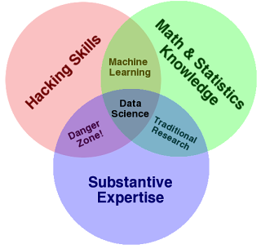
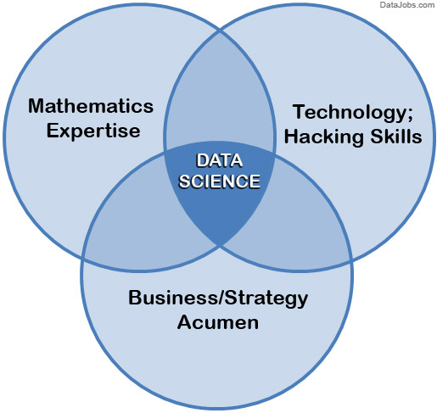
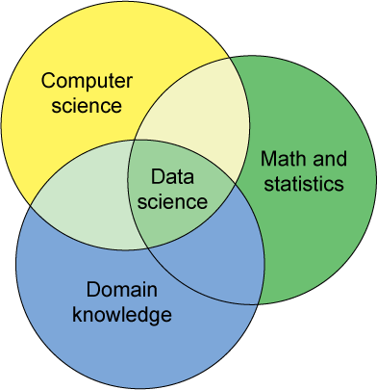
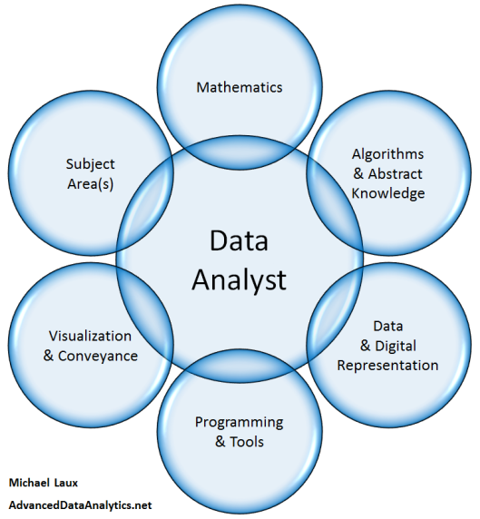
Data Scientist definitions: From Math to Hacking Early Data Science definitions
Strongly depend on the background of the Data Scientist
Biased and made for case
Improved in the EDISON project

Slide 18
Becoming a Data Scientist by Swami Chandrasekaran (2013) http://nirvacana.com/thoughts/becoming-a-data-scientist/
Good and practical advice how to learn Data Science, step by step
Follow the route

Slide 19
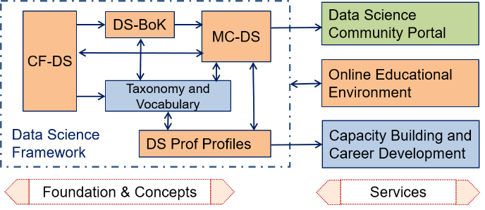
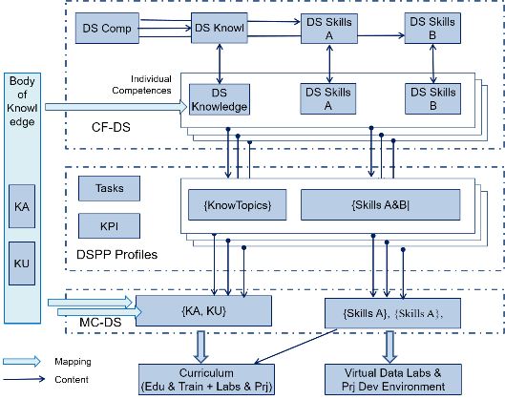
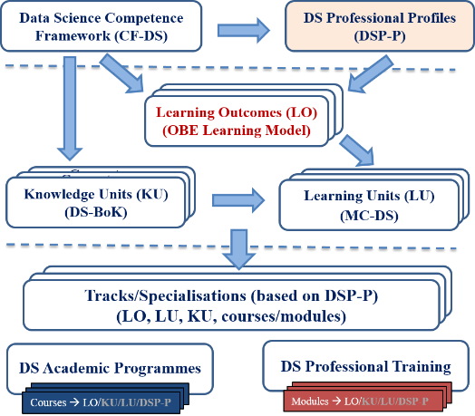
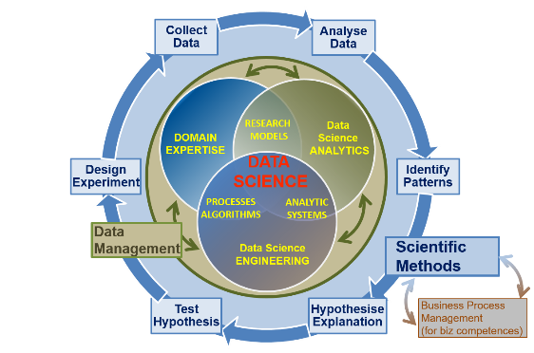
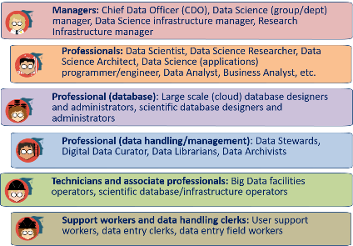
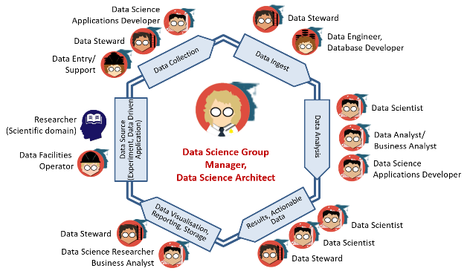
EDISON Products for Data Science Skills Management and Curriculum Design
EDISON Data Science Framework (EDSF)
Compliant with EU standards on competences and professional occupations e-CFv3.0, ESCO
Customisable courses design for targeted education and training
Skills development and career management for Core Data Experts and related data handling professions
Capacity building and Data Science team design
Academic programmes and professional training courses (self) assessment and design
Cooperation with International professional organisations IEEE, ACM, BHEF, APEC (AP Economic Cooperation )

Slide 20
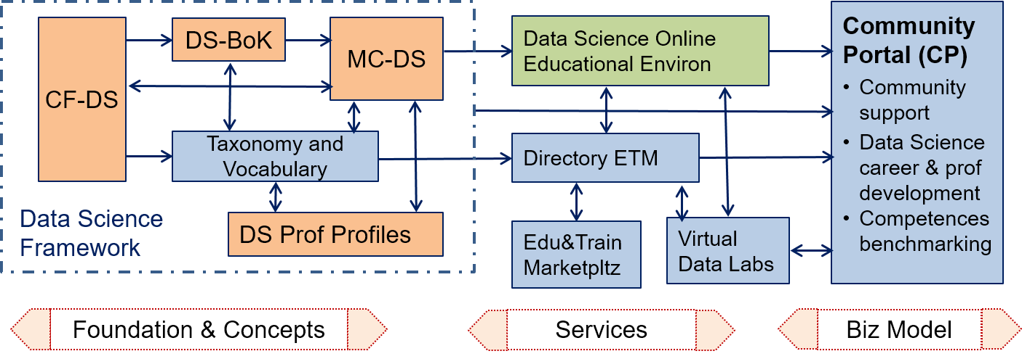
EDISON Data Science Framework (EDSF)
EDISON Framework components
CF-DS – Data Science Competence Framework
DS-BoK – Data Science Body of Knowledge
MC-DS – Data Science Model Curriculum
DSP – Data Science Professional profiles
Data Science Taxonomies and Scientific Disciplines Classification
EOEE - EDISON Online Education Environment
Methodology
ESDF development based on job market study, existing practices in academic, research and industry.
Review and feedback from the ELG, expert community, domain experts.
Input from the champion universities and community of practice.

Slide 21
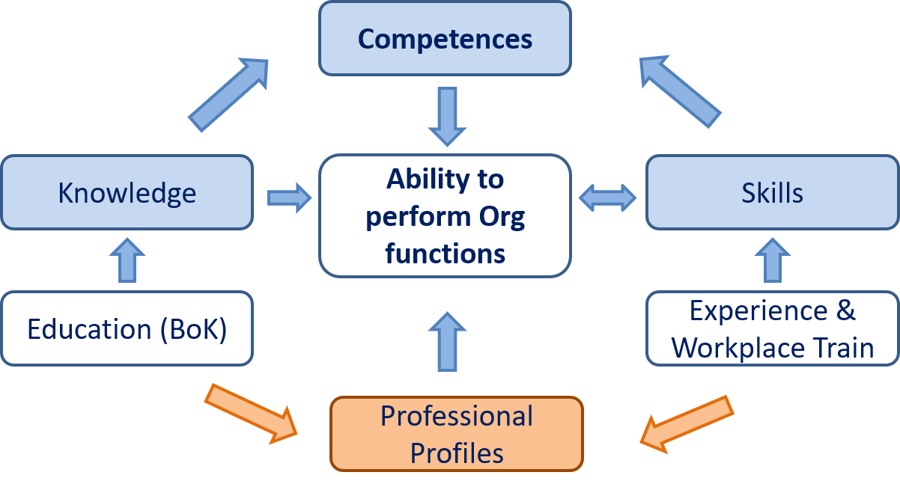
Competences Map to Knowledge and Skills
Competence is a demonstrated ability to apply knowledge, skills and attitudes for achieving observable results

Slide 22

Data Scientist definition
Based on the definitions by NIST SP1500 – 2015, extended by EDISON
A Data Scientist is a practitioner who has sufficient knowledge in the overlapping regimes of expertise in business needs, domain knowledge, analytical skills, and programming and systems engineering expertise to manage the end-to-end scientific method process through each stage in the big data lifecycle till the delivery of an expected scientific and business value to organisation or project.
Core Data Science competences and skills groups
Data Science Analytics (including Statistical Analysis, Machine Learning, Business Analytics)
Data Science Engineering (including Software and Applications Engineering, Data Warehousing, Big Data Infrastructure and Tools)
Domain Knowledge and Expertise (Subject/Scientific domain related)
EDISON identified 2 additional competence groups demanded by organisations
Data Management, Data Governance, Stewardship, Curation, Preservation
Research Methods and/vs Business Processes/Operations
Data Science professional skills: Thinking and acting like Data Scientist – required to successfully develop as a Data Scientist and work in Data Science teams

Slide 23

Data Science Competence Groups - Research
Data Science Competences include 5 groups
Data Science Analytics
Data Science Engineering
Domain Knowledge and Expertise
Data Management
Research Methods and Project Management
Business Process Management (biz)
Scientific Methods
Design Experiment
Collect Data
Analyse Data
Identify Patterns
Hypothesis Explanation
Test Hypothesis
Business Operations
Operations Strategy
Plan
Design & Deploy
Monitor & Control
Improve & Re-design

Slide 24
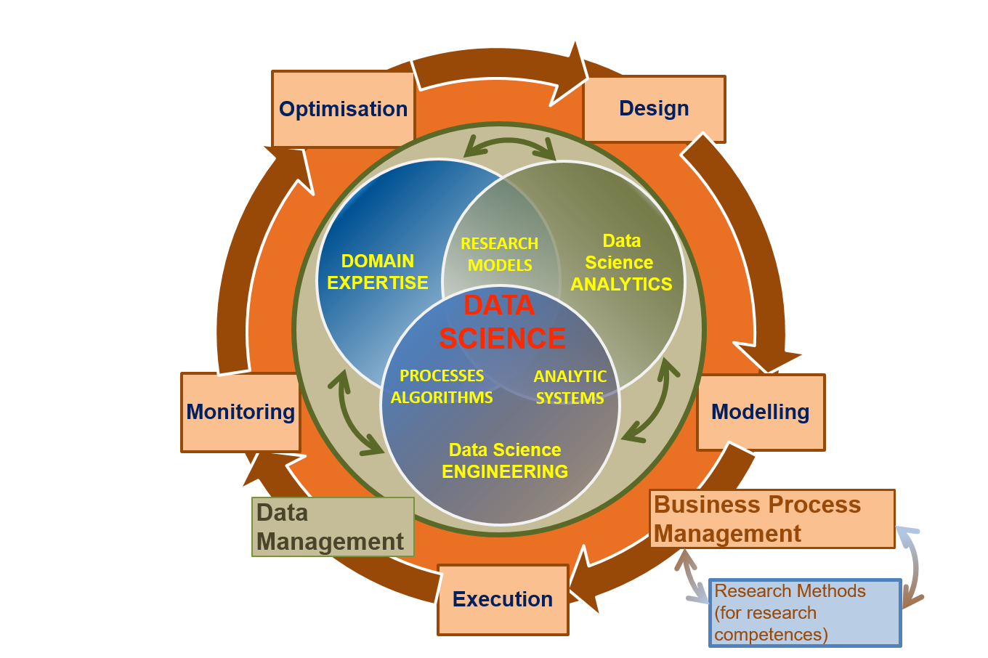
Data Science Competences Groups – Business
Data Science Competences include 5 groups
Data Science Analytics
Data Science Engineering
Domain Knowledge and Expertise
Data Management
Research Methods and Project Management
Business Process Management (biz)
Scientific Methods
Design Experiment
Collect Data
Analyse Data
Identify Patterns
Hypothesise Explanation
Test Hypothesis
Business Process Operations/Stages
Design
Model/Plan
Deploy & Execute
Monitor & Control
Optimise & Re-design

Slide 25
Identified Data Science Competence Groups
 | Data Science Analytics (DSDA) | Data Science Engineering (DSENG) | Data Management and Governance (DSDM) | Research/Scientific Methods and Project Management (DSRMP) | Data Science Domain Knowledge, e.g. Business Analytics (DSDK/DSBPM)
0 | Use appropriate data analytics and statistical techniques on available data to deliver insights into research problem or org. processes and support decision making | Use engineering principles and modern computer technology to research, design, implement new data analytics applications, develop experiments, processes, instruments, systems and infrastructures to support data handling during the whole data lifecycle | Develop and implement data management strategy for data collection, storage, preservation, and availability for further processing. | Create new understandings and capabilities by using the scientific method (hypothesis, test/artefact, evaluation) or similar engineering methods to discover new approaches to create new knowledge and achieve research or organisational goals | DSDK/DSBA Use domain knowledge (scientific or business) to develop relevant data analytics applications; adopt general Data Science methods to domain specific data types and presentations, data and process models, organisational roles and relations
1 | DSDA01 Effectively use variety of data analytics techniques | DSENG01 Use engineering principles (general and software) to research, design, develop and implement new instruments and applications | DSDM01 Develop and implement data strategy, in particular, Data Management Plan (DMP) | DSRMP01 Create new understandings and capabilities by using scientific/ research methods | DSBPM01 Understand business and provide insight, translate unstructured business problems into an abstract mathematical framework
2 | DSDA02 Apply designated quantitative techniques | DSENG02 Develop and apply computer methods to domain related problems | DSDM02 Develop data models including metadata | DSRMP02 Direct systematic study toward a fuller knowledge or understanding of the observable facts | DSBPM02 Participate strategically and tactically in financial decisions
3 | DSDA03 Pull together data from diff sources … | DSENG03 Develop and prototype data analytics applications | DSDM03 Collect integrate data | DSRMP03 Undertakes creative work | DSBPM03 Provides support services to other
4 | DSDA04 Use diff perform techniques | DSENG04 Develop, deploy operate Big Data storage | DSDM04 Maintain repository | DSRMP04 Translate strategies into actions | DSBPM04 Analyse data for marketing
5 | DSDA05 Develop analytics applic | DSENG05 Apply security mechanisms | DSDM05 Visualise cmplx data | DSRMP05 Contribute to organis goals | DSBPM05 Analyse optimise customer relatio
6 | DSDA06 Visualise results of analysis, dashboards | DSENG06 Design, build, operate SQL and NoSQL | DSRM06 Develop and manage prolicies | DSRMP06 Develop and guide data driven projects | DSBPM06 Analyse data for marketing

Slide 26
Identified Data Science Skills/Experience Groups
Skills Type A – Based on knowledge acquired
Group 1: Skills/experience related to competences
Data Analytics and Machine Learning
Data Management/Curation (including both general data management and scientific data management)
Data Science Engineering (hardware and software) skills
Scientific/Research Methods or Business Process Management
Application/subject domain related (research or business)
Group 2: Mathematics and statistics
Mathematics and Statistics and others
Skills Type B – Base on practical or workplace experience
Group 3: Big Data (Data Science) tools and platforms
Big Data Analytics platforms
Mathematics & Statistics applications & tools
Databases (SQL and NoSQL)
Data Management and Curation platform
Data and applications visualisation
Cloud based platforms and tools
Group 4: Data analytics programming languages and IDE
General and specialized development platforms for data analysis and statistics
Group 5: Soft skills and Workplace skills
Data Science professional skills: Thinking and Acting like Data Scientist
21st Century Skills: Personal, inter-personal communication, team work, professional network

Slide 27
Group 5: Soft skills and Workplace skills
Data Science professional skills: Thinking and Acting like Data Scientist
21st Century Skills: Personal, inter-personal communication, team work, professional network
Digital Transformation Industry 4.0 and Digital Skills
Data Scientist and Subject Domain Specialist

Slide 28
Thinking and Acting like Data Scientist
Recognise value of data, work with raw data, exercise good data intuition, use SN and open data
Accept (be ready for) iterative development, know when to stop, comfortable with failure, accept the symmetry of outcome (both positive and negative results are valuable)
Good sense of metrics, understand importance of the results validation, never stop looking at individual examples
Ask the right questions
Respect domain/subject matter knowledge in the area of data science
Data driven problem solver and impact-driven mindset
Be aware about power and limitations of the main machine learning and data analytics algorithms and tools
Understand that most of data analytics algorithms are statistics and probability based, so any answer or solution has some degree of probability and represent an optimal solution for a number of variables and factors
Recognise what things are important and what things are not important (in data modeling)
Working in agile environment and coordinate with other roles and team members
Work in multi-disciplinary team, ability to communicate with the domain and subject matter experts
Embrace online learning/training, continuously improve your knowledge, be involved professional networks and communities
Story Telling: Deliver actionable result of your analysis
Attitude: Creativity, curiosity (willingness to challenge status quo), commitment in finding new knowledge and progress to completion
Ethics and responsible use of data and insight delivered, awareness of dependability (data scientist is a feedback loop in data driven companies)

Slide 29
21st Century Skills (DARE & BHEF & EDISON)
Critical Thinking: Demonstrating the ability to apply critical thinking skills to solve problems and make effective decisions
Communication: Understanding and communicating ideas
Collaboration: Working with other, appreciation of multicultural difference
Creativity and Attitude: Deliver high quality work and focus on final result, initiative, intellectual risk
Planning & Organizing: Planning and prioritizing work to manage time effectively and accomplish assigned tasks
Business Fundamentals: Having fundamental knowledge of the organization and the industry
Customer Focus: Actively look for ways to identify market demands and meet customer or client needs
Working with Tools & Technology: Selecting, using, and maintaining tools and technology to facilitate work activity
Dynamic (self-) re-skilling: Continuously monitor individual knowledge and skills as shared responsibility between employer and employee, ability to adopt to changes
Professional networking: Involvement and contribution to professional network activities
Ethics: Adhere to high ethical and professional norms, responsible use of power data driven technologies, avoid and disregard un-ethical use of technologies and biased data collection and presentation

Slide 30





























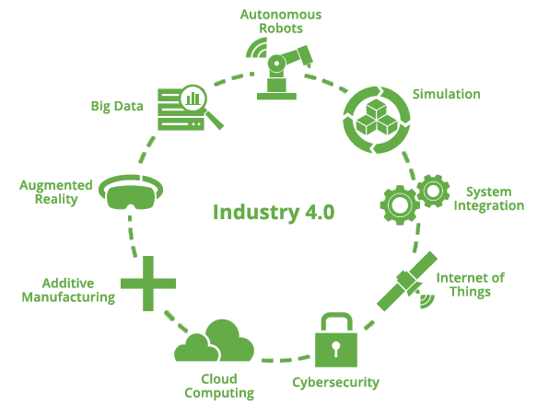































Maritime Industry Digital Transformation and Skills Strategy – Toward Industry 4.0
OCCUPATIONAL PROFILES
CURRICULUM DESIGN
EDUCATION & TRAINING
KNOWLEDGE TRANSFER
LONG-TERM SKILLS STRATEGY
OCEAN LITERACY
Digital Competences/Skills
Information and data literacy
Managing data, information, knowledge
Digital content, programming
Digital security and safety
Communication and collaboration
Problem solving and critical thinking
Digital competence and skills are transversal:
Spans from direct professional activity at all levels to attitude and entrepreneurship.
Multiple competence and skills groups targeted by (continuous) education and training
Digital Transformation
Digitation and IoT
Digitalisation of Processes
Optimisation and Simulation
Intelligent Information and Knowledge Management
Data Management Maturity
Digital Assets Manage
Agile Data Driven Organisational Model
Customer Experience
People and skills
Big Data
System
Integration
Additive
Manufacturing
Internet of
Things

Slide 31
Data Scientist and Subject Domain Specialist
Subject domain components
Model (and data types)
Methods
Processes
Domain specific data and presentation/visualization methods
Organisational roles and relations
Data Scientist is an assistant to Subject Domain Specialists
Translate subject domain Model, Methods, Processes into abstract data driven form
Implement computational models in software, build required infrastructure and tools
Do (computational) analytic work and present it in a form understandable to subject domain
Discover new relations originated from data analysis and advice subject domain specialist
Present/visualise information in domain related actionable way
Interact and cooperate with different organizational roles to obtain data and deliver results and/or actionable data

Slide 32
Data Science and Subject Domains
Data Science domain components
Data structures & databases/storage
Visualisation
Abstract data driven math&compute models
Data Analytics methods
Data and Applications Lifecycle Management
Cross-organisational
assistive role
Data Scientist/Data Steward functions is to translate between two domains
Domain specific components
Domain specific data & presentation
(visualization)
Models (and data types)
Methods
Processes
Organisational
roles
Data Scientist role is to maintain the Data Value Chain (domain specific):
Data Integration => Organisation/Process/Business Optimisation => Innovation

Slide 33
Practical Application of the CF-DS
Basis for the definition of the Data Science Body of Knowledge (DS-BoK) and Data Science Model Curriculum (MC-DS)
CF-DS => Learning Outcomes (MC-DS) => Knowledge Areas (DS-BoK)
CF-DS => Data Science taxonomy of scientific subjects and vocabulary
Data Science professional profiles definition
Extend existing EU standards and occupations taxonomies: e-CFv3.0, ESCO, others
Professional competence benchmarking
For customizable training and career development
Including CV or organisational profiles matching
Professional certification
In combination with DS-BoK professional competences benchmarking
Vacancy construction tool for job advertisement (for HR)
Using controlled vocabulary and Data Science Taxonomy
Candidates’ CV assessment

Slide 34
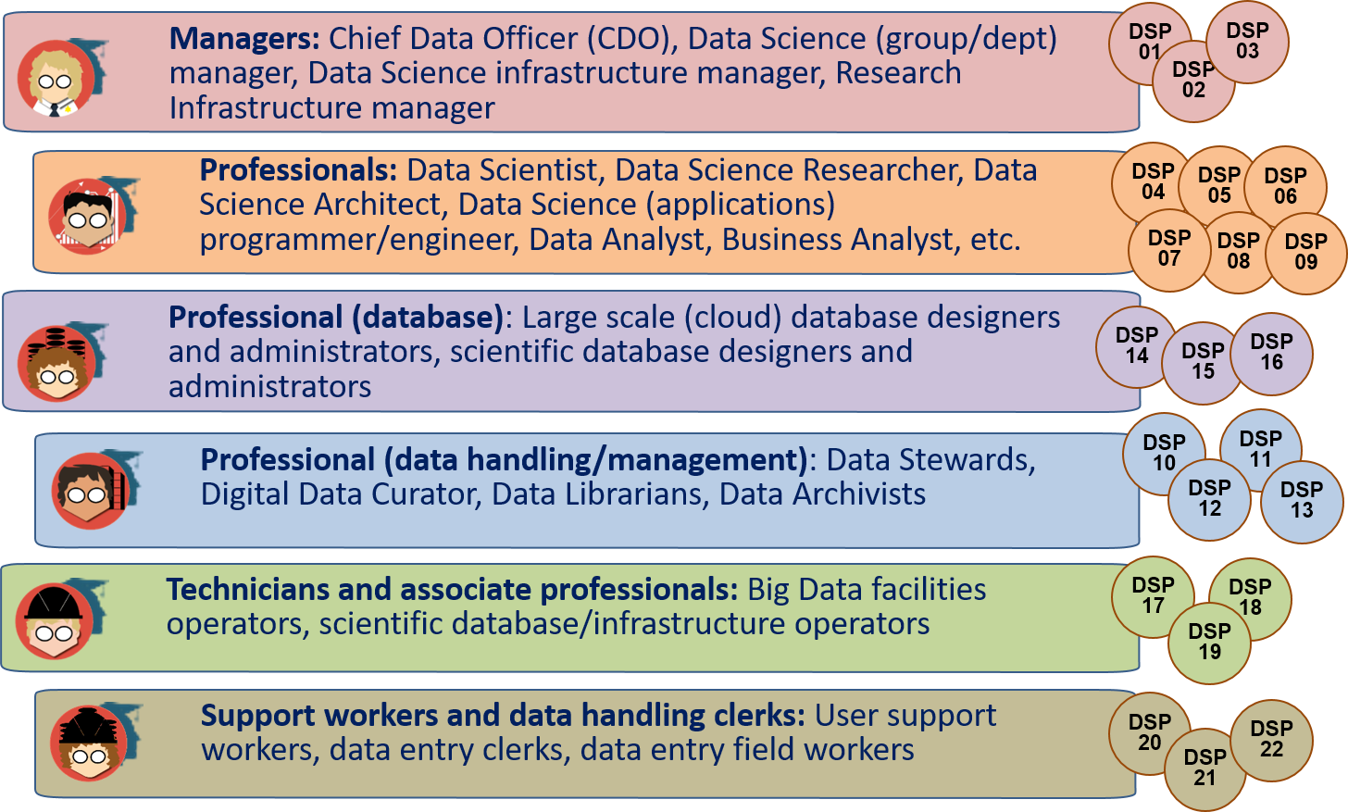
Data Science Professions Family - Compliant EU standard ESCO (EU Skills, Competences, Occupations 2017)
Icons used: Credit to [ref] https://www.datacamp.com/community/tutorials/data-science-industry-infographic

Slide 35
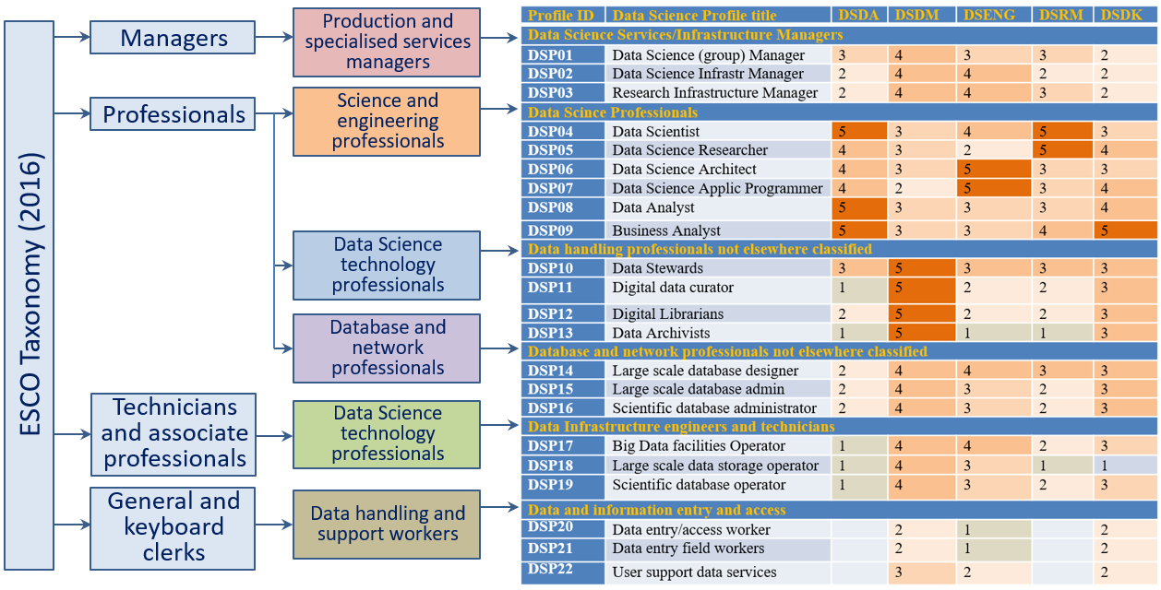
DSP Profiles mapping to ESCO Taxonomy High Level Groups
DSP Profiles mapping to corresponding CF-DS Competence Groups
Relevance level from 5 – maximum to 1 – minimum

Slide 36
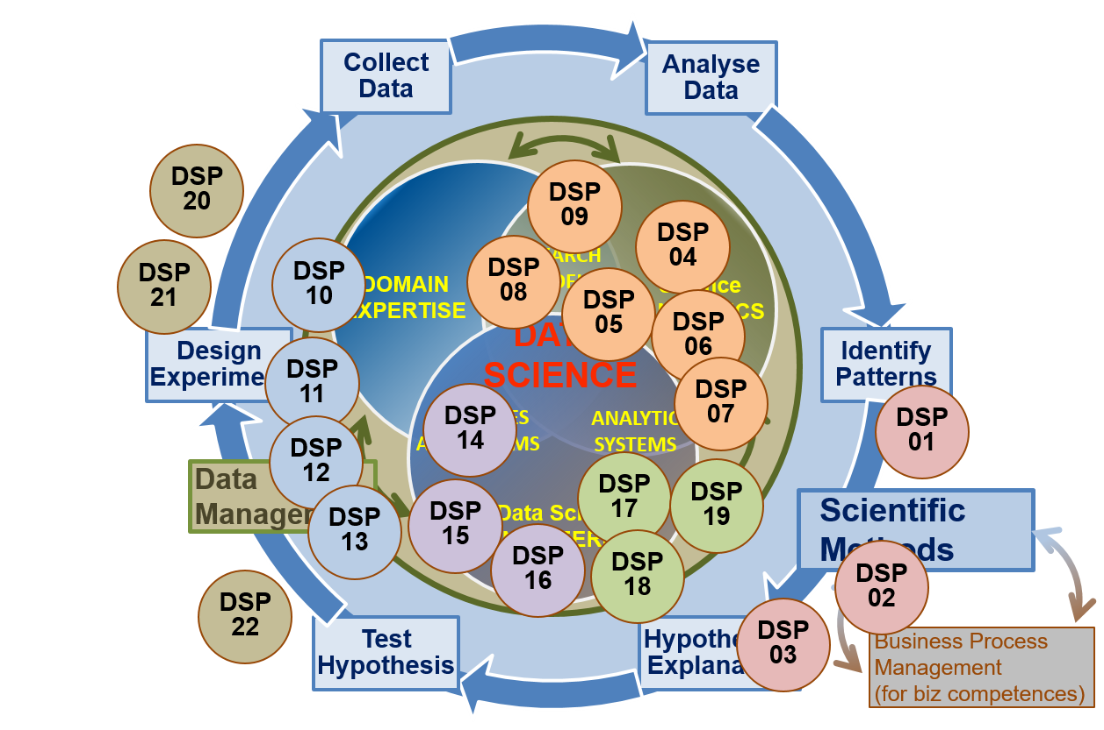
CF-DS and Data Science Professional Profiles

Slide 37
EDSF for Education and Training
Foundation and methodological base
Data Science Body of Knowledge (DS-BoK)
Taxonomy and classification of Data Science related scientific subjects
Data Science Model Curriculum (MC-DS)
Set Learning Units mapped to CF-DS Learning and DS-BoK Knowledge Areas/Units
Instructional methodologies and teaching models
Platforms and environment
Virtual labs, datasets, developments platforms
Online education environment and courses management
Services
Individual benchmarking and profiling tools (competence assessment)
Knowledge evaluation tools
Certifications and training for self-made Data Scientists practitioners
Education and training marketplace: Courses catalog and repository

Slide 38

Data Science Body of Knowledge (DS-BoK)
DS-BoK Knowledge Area Groups (KAG)
KAG1-DSA: Data Analytics group including Machine Learning, statistical methods, and Business Analytics
KAG2-DSE: Data Science Engineering group including Software and infrastructure engineering
KAG3-DSDM: Data Management group including data curation, preservation and data infrastructure
KAG4-DSRM: Research Methods and Project Management group
KAG5-DSBA: Business Analytics and Business Intelligence
KAG* - DSDK: Data Science domain knowledge to be defined by related expert groups

Slide 39
Data Science Body of Knowledge (1)
KA Groups | Suggested DS Knowledge Areas (KA) | Knowledge Areas from existing BoK and CCS2012 scientific subject groups
KAG1-DSDA: Data Science Analytics | KA01.01 (DSDA.01/SMDA) Statistical methods for data analysis KA01.02 (DSDA.02/ML) Machine Learning KA01.03 (DSDA.03/DM) Data Mining KA01.04 (DSDA.04/TDM) Text Data Mining KA01.05 (DSDA.05/PA) Predictive Analytics KA01.06 (DSDA.06/MODSIM) Computational modelling, simulation and optimisation | There is no formal BoK defined for Data Analytics. Data Science Analytics related scientific subjects from CCS2012: CCS2012: Computing methodologies CCS2012: Mathematics of computing CCS2012: Computing methodologies
KAG2-DSENG: Data Science Engineering | KA02.01 (DSENG.01/BDI) Big Data Infrastructure and Technologies KA02.02 (DSENG.02/DSIAPP) Infrastructure and platforms for Data Science applications KA02.03 (DSENG.03/CCT) Cloud Computing technologies for Big Data and Data Analytics KA02.04 (DSENG.04/SEC) Data and Applications security KA02.05 (DSENG.05/BDSE) Big Data systems organisation and engineering KA02.06 (DSENG.06/DSAPPD) Data Science (Big Data) applications design KA02.07 (DSENG.07/IS) Information systems (to support data driven decision making) | ACM CS-BoK selected KAs: AR - Architecture and Organization (including computer architectures and network architectures) CN - Computational Science IM - Information Management SE - Software Engineering (can be extended with specific SWEBOK KAs) SWEBOK selected KAs Software requirements Software design Software engineering process Software engineering models and methods Software quality Data Science Analytics related scientific subjects from CCS2012

Slide 40
Data Science Body of Knowledge (2)
KA Groups | Suggested DS Knowledge Areas (KA) | Knowledge Areas from existing BoK and CCS2012 scientific subject groups
KAG3-DSDM: Data Management | KA03.01 (DSDM.01/DMORG) General principles and concepts in Data Management and organisation KA03.02 (DSDM.02/DMS) Data management systems KA03.03 (DSDM.03/EDMI) Data Management and Enterprise data infrastructure KA03.04 (DSDM.04/DGOV) Data Governance KA03.05 (DSDM.05/BDST0R) Big Data storage (large scale) KA03.06 (DSDM.05/DLIB) Digital libraries and archives | DM-BoK selected KAs (1) Data Governance, (2) Data Architecture, (3) Data Modelling and Design, (4) Data Storage and Operations, (5) Data Security, (6) Data Integration and Interoperability, (7) Documents and Content, (8) Reference and Master Data, (9) Data Warehousing and Business Intelligence, (10) Metadata, and (11) Data Quality.
KAG4-DSRM: Research Methods and Project Management | KA04.01 (DSRMP.01/RM) Research Methods KA04.01 (DSRMP.02/PM) Project Management | There are no formally defined BoK for research methods PMI-BoK selected KAs Project Integration Management Project Scope Management Project Quality Project Risk Management
KAG5-DSBPM: Business Analytics | KA05.01 (DSBA.01/BAF) Business Analytics Foundation KA05.02 (DSBA.02/BAEM) Business Analytics organisation and enterprise management | BABOK selected KAs *) Business Analysis Planning and Monitoring Requirements Life Cycle Management Solution Evaluation and improvements recommendation

Slide 41
KAG3-DSDM: Data Management group: data curation, preservation and data infrastructure
DM-BoK version 2 “Guide for performing data management” – 11 Knowledge Areas
(1) Data Governance
(2) Data Architecture
(3) Data Modelling and Design
(4) Data Storage and Operations
(5) Data Security
(6) Data Integration and Interoperability
(7) Documents and Content
(8) Reference and Master Data
(9) Data Warehousing and Business Intelligence
(10) Metadata
(11) Data Quality
Other Knowledge Areas motivated by RDA, European Open Data initiatives, European Open Data Cloud
(12) PID, metadata, data registries
(13) Data Management Plan
(14) Open Science, Open Data, Open Access, ORCID
(15) Responsible data use
Highlighted in red: Considered (Research) Data Management literacy (minimum required knowledge)

Slide 42
Data Science Model Curriculum (MC-DS)
Data Science Model Curriculum includes
Learning Outcomes (LO) definition based on CF-DS
LOs are defined for CF-DS competence groups and for all enumerated competences
Knowledge levels: Familiarity, Usage, Assessment (based in Bloom’s Taxonomy)
LOs mapping to Learning Units (LU)
LUs are based on CCS(2012) and universities best practices
Data Science university programmes and courses inventory (interactive) http://edison-project.eu/university-programs-list
LU/course relevance: Mandatory Tier 1, Tier 2, Elective, Prerequisite
Learning methods and learning models (in progress)

Slide 43

Outcome Based Educations and Training Model
From Competences and DSP Profiles
to Learning Outcomes (LO) and
to Knowledge Unites (KU) and Learning Units (LU)
EDSF allow for customized educational courses and training modules design

Slide 44
DSP04 – Data Scientist MC structure

Slide 45
DSP10 – Data Steward MC structure

Slide 46
DSP04 Data Scientist – Required practical skills and Hands-on labs
Data Science curriculum should include the following elements to achieve necessary skills Type B:
Python (or R) and corresponding data analytics libraries
NoSQL and SQL Databases (Hbase, MongoDB, Cassandra, Redis, Accumulo, MS SQL, My SQL, PostgreSQL, etc.)
Big Data Analytics platforms (Hadoop, Spark, Data Lakes, others)
Real time and streaming analytics systems (Flume, Kafka, Storm)
Visualisation software (D3.js, Processing, Tableau, Julia, Raphael, etc.)
Web API management and web scrapping
Git versioning system as a general platform for software development
Kaggle competition, resources and community platform, including rich data sets, forum and computing resources
Development Frameworks: Python, Java or C/C++, AJAX (Asynchronous Javascript and XML), D3.js (Data-Driven Documents), jQuery, others
Cloud based Big Data and data analytics platforms and services, including large scale storage systems
Essential for workplace adjustment

Slide 47
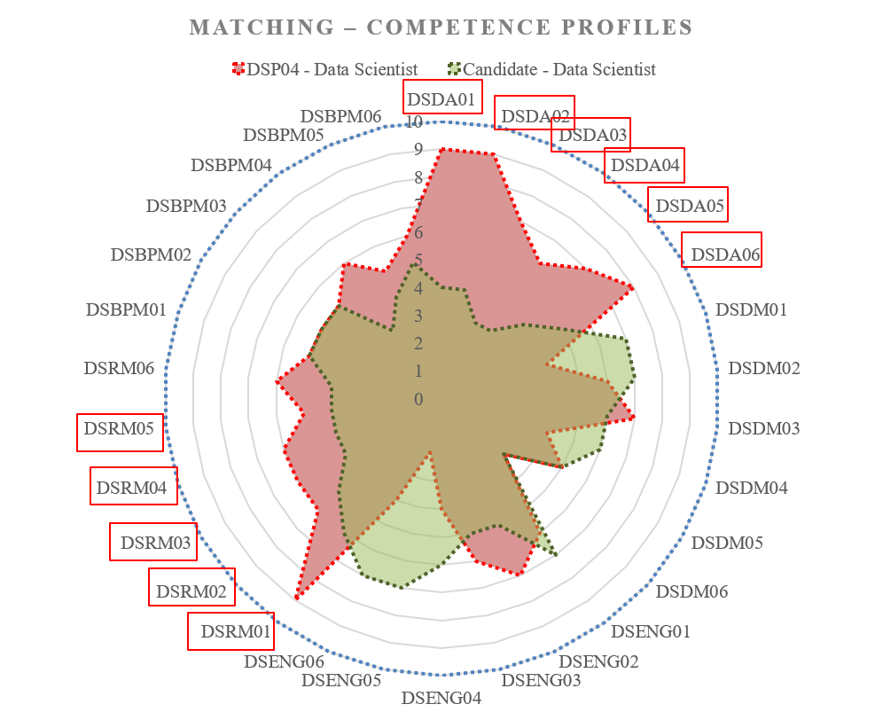
Individual Competences Benchmarking
Individual Education/Training Path based on Competence benchmarking
Red polygon indicates the chosen professional profile: Data Scientist (general)
Green polygon indicates the candidate or practitioner competences/skills profile
Insufficient competences (gaps) are highlighted in red
DSDA01 – DSDA06 Data Science Analytics
DSRM01 – DSRM05 Data Science Research Methods
Can be use for team skills match marking and organisational skills management
[ref] For DSP Profiles definition and for enumerated competences refer to EDSF documents CF-DS and DSP Profiles.

Slide 48
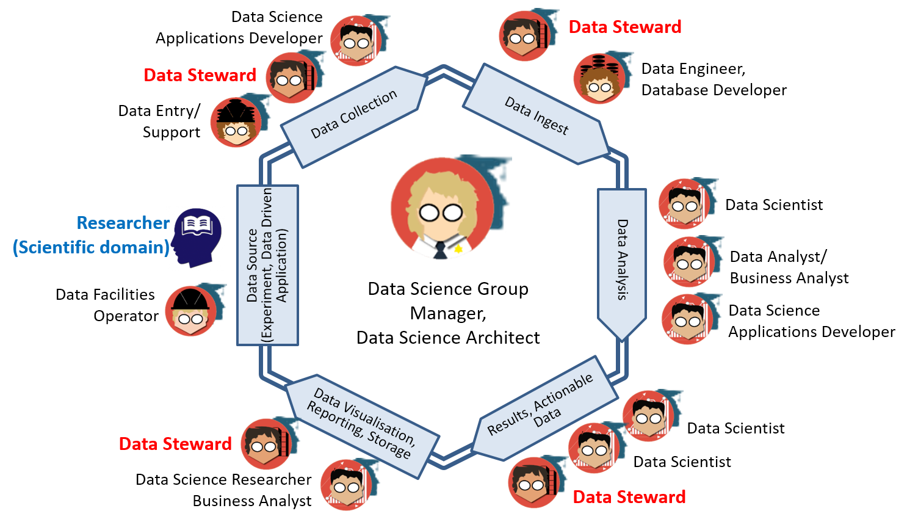
Building a Data Science Team

Slide 49
Data Science or Data Management Group/Department: Organisational structure and staffing - EXAMPLE
Data Science or Data Management Group/Department
(Managing) Data Science Architect (1)
Data Scientist (1), Data Analyst (1)
Data Science Application programmer (2)
Data Infrastructure/facilities administrator/operator: storage, cloud, computing (1)
Data stewards, curators, archivists (3-5)
Estimated: Group of 10-12 data specialists for research institution of 200-300 research staff.
Growing role and demand for Data Stewards and data stewardship
>> Reporting to CDO/CTO/CEO
Providing cross-organizational
services

Slide 50
Data Stewardship in Research and FAIR Principles
FAIR Initiative by Dutch Techcentre for Life Science (DTLS) – Prof. Barend Mons
Supported by Germany, France, Spain, UK, USA
Part of Horizon 2020 Programme
FAIR Principles for research data: Findable – Accessible – Interoperable - Reusable
Data Stewards as a key bridging role between Data Scientists as (hard)core data experts and scientific domain researchers (HLEG EOSC report)
Current definition of the Data Steward (part of Data Science Professional profiles)
Data Steward is a data handling and management professional whose responsibilities include planning, implementing and managing (research) data input, storage, search, and presentation.
Data Steward creates data model for domain specific data, support and advice domain scientists/ researchers during the whole research cycle and data management lifecycle.
HLEG report on European Open Science Cloud
(October 2016)

Slide 51
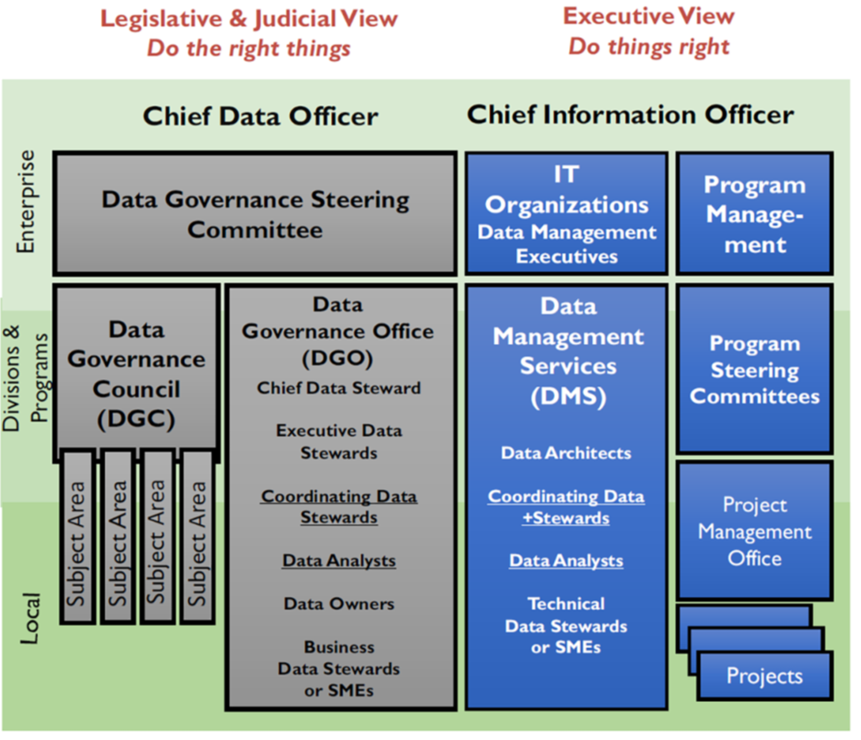
Data Governance Organisation Parts and Roles
Separation or governance responsibilities
Multi-layer
CDO
CIO
Councils
Data Stewardship
DAMA Data Management Body of Knowledge
(DMBOKv1.0, 2007)
[ref] DAMA-DMBOK Data Management Body of Knowledge, 2nd Edition, 2017

Slide 52
Discussion: How to become a Data Scientist
A lot of information and different paths
There are essential knowledge and competences
However most of them require strong background in mathematics, statistics, programming, infrastructure, etc.

Slide 53
Discussion: How to become a Data Scientist
Understand required Data Science and Analytics competences and skills
Build your own learning path
Assess your knowledge and start from basics
Statistics is foundation of Data (Science) Analytics
Develop statistical/probabilistic thinking
Difference between Data Science and statistics
Learn from others experience: read blogs, join forums and communities
Decide about academic degree, professional certificate, self-education/training, join local Meetup
Start applying for job
Remember variety of Data Scientist roles and profiles
Understand what company is actually looking for

Slide 54
Data Science and Data Mining
Data mining (knowledge discovery from data)
Extraction of interesting (non-trivial, implicit, previously unknown and potentially useful) patterns or knowledge from huge amount of data
Alternative names
Knowledge discovery (mining) in databases (KDD), knowledge extraction, data/pattern analysis, data archeology, data dredging, information harvesting, business intelligence, etc.
Watch out: Is everything “data mining”?
Simple search and query processing
(Deductive) expert systems

Slide 55
CRISP DM process: Processes and Data Lifecycle
Business
Understanding
Data Understanding
Data Preparation
Deployment
Data
Modeling
Evaluation
Cross Industry Standard Process for Data Mining (CRISP-DM)

Slide 56
Online Educational and training resources on Data Science
LinkedIn Education
Microsoft Virtual Academy (MVA)
(IBM – in transition)
DataCamp
Coursera, Udacity
Certification and training by PMI, DAMA, IIBA

Slide 57
Open Data and Educational Datasets
Amazon Web Services (AWS)
Google
Microsoft Azure
Kaggle
KDNuggets

Slide 58
Questions and discussion

Slide 59
Other related links
Amsterdam School of Data Science
https://www.schoolofdatascience.amsterdam/
https://www.schoolofdatascience.amsterdam/education/
Research Data Alliance interest Group on Education and Training on Handling of Research Data (IG-ETHRD)
https://www.rd-alliance.org/groups/education-and-training-handling-research-data.html
Final Report on European Data Market Study by IDC (Feb 2017)
https://ec.europa.eu/digital-single-market/en/news/final-results-european-data-market-study-measuring-size-and-trends-eu-data-economy
PwC and BHEF report “Investing in America’s data science and analytics talent: The case for action” (April 2017)
http://www.bhef.com/publications/investing-americas-data-science-and-analytics-talent
Burning Glass Technology, IBM, and BHEF report “The Quant Crunch: How the demand for Data Science Skills is disrupting the job Market” (April 2017)
http://www.bhef.com/publications/quant-crunch-how-demand-data-science-skills-disrupting-job-market
https://public.dhe.ibm.com/common/ssi/ecm/im/en/iml14576usen/IML14576USEN.PDF
Millennials at work: Reshaping the workspace (2016)
https://www.pwc.com/m1/en/services/consulting/documents/millennials-at-work.pdf
This work is licensed under the Creative Commons Attribution 4.0 International License. To view a copy of this license, visit http://creativecommons.org/licenses/by/4.0/

Slide 60
Additional materials

Slide 61
Types of Data Mining (branch of Data Analysis)
Regression
Classification
Clustering
Feature Selection
Data Mining
Association
Text Mining
Anomaly detection
, Time Series

Slide 62
Data Mining: Confluence of Multiple Disciplines
Machine
Learning
Pattern
Recognition
Statistics
Applications
Data Mining
Visualization
Algorithm
Cloud Computing
and HPC
Database
Technology

Slide 63
CRISP DM process: Processes and Data Lifecycle
Business
Understanding
Data Understanding
Data Preparation
Deployment
Data
Modeling
Evaluation
Cross Industry Standard Process for Data Mining (CRISP-DM)

Slide 64
Process of Data Analysis
Business
Understanding
Data Understanding
1. Prior Knowledge
Prepare Data
2. Preparation
Training Data
Building Model using Algorithms
3. Modeling
Test Data
Applying Model and performance evaluation
4. Application
Deployment
5. Knowledge
Knowledge and Actions

